Slide 1
Mathematical Induction
CSE 2213:
Discrete Mathematics
Lecture 09
Based on: https://courses.cs.duke.edu//summer13/compsci230/restricted/lectures/L09-10.pdf

Slide 2
Outline
Mathematical Induction
Strong Induction (definition only)

Slide 3
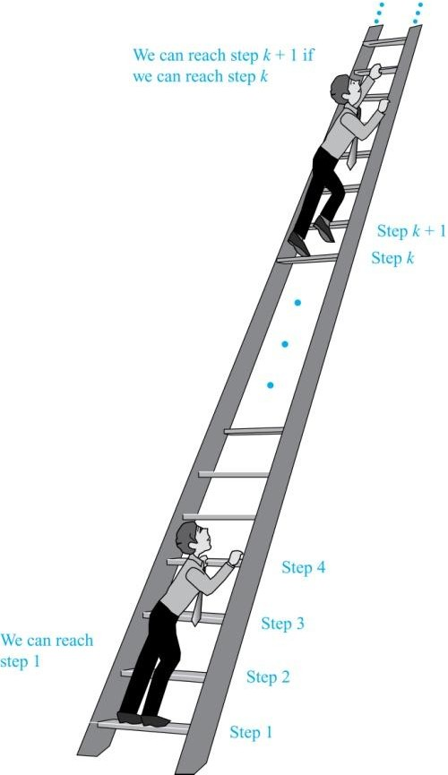
Climbing an Infinite Ladder
Suppose we have an infinite ladder:
We can reach the first rung of the ladder.
If we can reach a particular rung of the ladder, then we can reach the next rung.
From (1), we can reach the first rung. Then by applying (2), we can reach the second rung. Applying (2) again, the third rung. And so on. We can apply (2) any number of times to reach any particular rung, no matter how high up.
This example motivates proof
by mathematical induction.

Slide 4
Principle of Mathematical Induction
Principle of Mathematical Induction: To prove that P(n) is true for all positive integers n, we complete these steps:
Basis Step: Show that P(1) is true.
Inductive Step: Show that P(k) → P(k + 1) is true for all positive integers k.
To complete the inductive step, assuming the inductive hypothesis that P(k) holds for an arbitrary integer k, show that
must P(k + 1) be true.
Climbing an Infinite Ladder Example:
Basis Step: By (1), we can reach rung 1.
Inductive Step: Assume the inductive hypothesis that we can reach rung k. Then by (2), we can reach rung k + 1.
Hence, P(k) → P(k + 1) is true for all positive integers k. We can reach every rung on the ladder.

Slide 5
Logic and Mathematical Induction
Mathematical induction can be expressed as the rule of inference:
(P(1) ∧ ∀k (P(k) → P(k + 1))) → ∀n P(n), where the domain is the set of positive integers.
In a proof by mathematical induction, we don’t assume that P(k) is true for all positive integers! We show that if we assume that P(k) is true, then P(k + 1) must also be true.
Proofs by mathematical induction do not always start at the
integer 1. In such a case, the basis step begins at a starting point b where b is an integer. We will see examples of this soon.

Slide 6
Why Mathematical Induction is Valid?
Mathematical induction is valid because of the well ordering property.
Proof:
Suppose that P(1) holds and P(k) → P(k + 1) is true for all positive integers k.
Assume there is at least one positive integer n for which P(n) is false. Then the set S of positive integers for which P(n) is false is nonempty.
By the well-ordering property, S has a least element, say m.
We know that m can not be 1 since P(1) holds.
Since m is positive and greater than 1, m − 1 must be a positive
integer. Since m − 1 < m, it is not in S, so P(m − 1) must be true.
But then, since the conditional P(k) → P(k + 1) for every positive integer k holds, P(m) must also be true. This contradicts P(m) being false.
Hence, P(n) must be true for every positive integer n.
In mathematics, the well-ordering principle states that every non-empty set of positive integers contains a least element

Slide 7
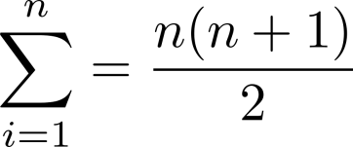
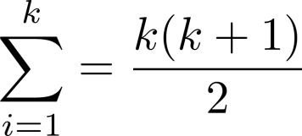
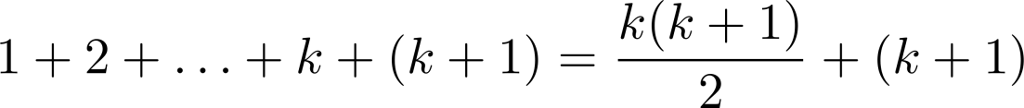
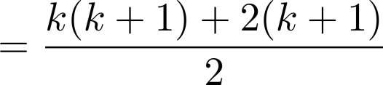
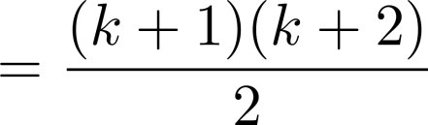

Proving a Summation Formula by Mathematical Induction
Example: Show that:
Solution:
Basis Step: P(1) is true since 1(1+1)/2 = 1.
Inductive Step: Assume true for P(k).
The inductive hypothesis is Under this assumption,

Slide 8
Exercise:
Show that the sum of first n positive odd numbers is n².
Let’s try to do this on our own first!

Slide 9
Exercise Solved
Example: Prove that the sum of first n positive odd numbers (integers) is n², i.e., 1 + 3 + 5 + · · · + (2n − 1) = n². (why ?)
Solution: Let S(n) = 1 + 3 + 5 + · · · + (2n − 1). We want to prove by induction that for every positive integer n, S(n) = n² .
Basis Step: If n = 1 we have S(1) = 1 = 1², so the property is true for 1.
Inductive Step: Assume (Induction Hypothesis) that the property is true for some positive integer n, i.e.: S(n) = n².
We must prove that it is also true for n + 1, i.e., S(n + 1) = (n + 1)².

Slide 10
Exercise Solved ..
(Inductive Step continues …)
In fact, as we are dealing with odd numbers, after (2n-1), we have (2n+1) [not 2n]. So,
S(n + 1) = 1 + 3 + 5 + · · · + (2n + 1) = S(n) + 2n + 1 .
But by induction hypothesis, S(n) = n², hence:
S(n + 1) = n² + 2n + 1 = (n + 1)² .
This completes the induction, and shows that the property is true for all positive integers.

Slide 11
Proving Inequalities
Example: Use mathematical induction to prove that n < 2^{n} for all positive integers n.
Solution: Let P(n) be the proposition that n < 2^{n}.
Basis Step: (1) is true since 1 < 2¹ = 2
Inductive Step: Assume P(k) holds, i.e., k < 2^{k}, for an arbitrary positive integer k.
Must show that P(k + 1) holds. Since by the inductive hypothesis, k < 2^{k}, it follows that:
k + 1 < 2^{k} + 1
≤ 2^{k} + 2^{k}
= 2 ∙ 2^{k}
= 2^{k+1}
Therefore,
n < 2^{n} holds for all positive integers, n.

Slide 12
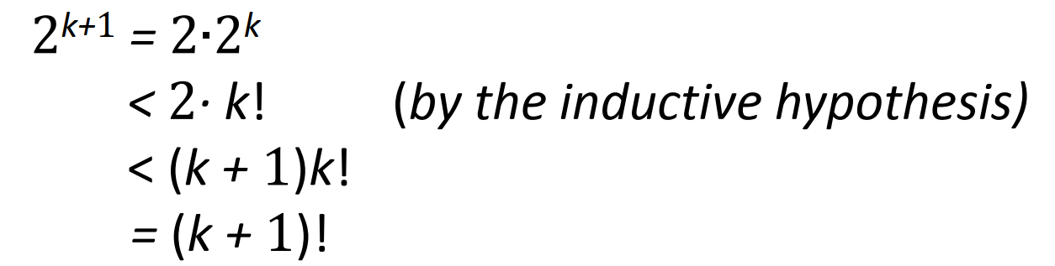
Proving Inequalities
Example: Use mathematical induction to prove that
2^{n} < n!, for every integer n ≥ 4.
Solution: Let P(n) be the proposition that 2^{n} < n!.
Basis: P(4) is true since 2⁴ = 16 < 4! = 24.
Inductive Step: Assume P(k) holds, i.e., 2^{k} < k! for an arbitrary integer k ≥ 4. To show that P(k + 1) holds:
Therefore, 2^{n} < n! holds, for every integer n ≥ 4.
Note: The basis step is P(4), since P(0), P(1), P(2), and P(3) are all false.

Slide 13
Strong Induction
Strong Induction: To prove that P(n) is true for all positive integers n, where P(n) is a propositional function, complete two steps:
Basis Step: Verify that the proposition P(1) is true.
Inductive Step: Show the conditional
Statement [P(1) ∧ P(2) ∧∙∙∙ ∧ P(k)] → P(k + 1) holds for all positive integers k.
Strong Induction is sometimes called the second principle of mathematical induction or complete induction.

Slide 14
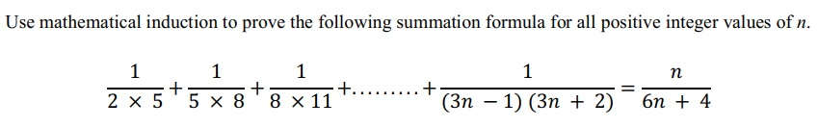
Practice Problem

Slide 15
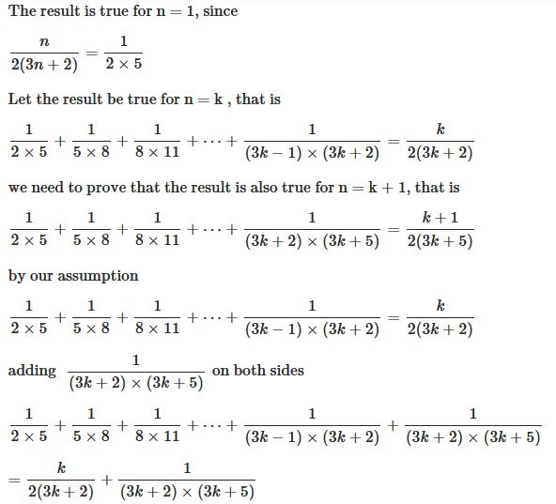
Proof
Basis:
Inductive:

Slide 16
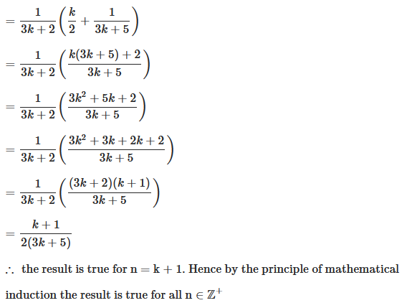
Proof (continued)

